Slide 1


Slide 2


Slide 3

Motivation
We noticed that meetings either over the internet or in person tends to be noisy and hard to understand. We wanted to make a system that would automate some of what a leader of a meeting would do as well as some other useful features like transcripts or audit logs. However, we realize that our webapp wouldn’t serve everyone so we made it a templated design to be easily forked and customized.

Slide 4


Background

Slide 5
Introduction
Any structured government, organization, or entity requires a form of procedure and order; a set of rules that maintain the flow of any official session of the entity.
AI’s Rules of Order (AiRoO) is to substitute the role of the chair. AIRoO a web app that allows the chair to build all the possible rules using structured blocks. Once in a meeting begins, AiRoO will take over the meeting using the rules it was given by the chair to maintain the flow and order. It will maintain the flow of the meeting by saying things the chair would have said and waiting for typed responses from the participants via the web-app.

Slide 6
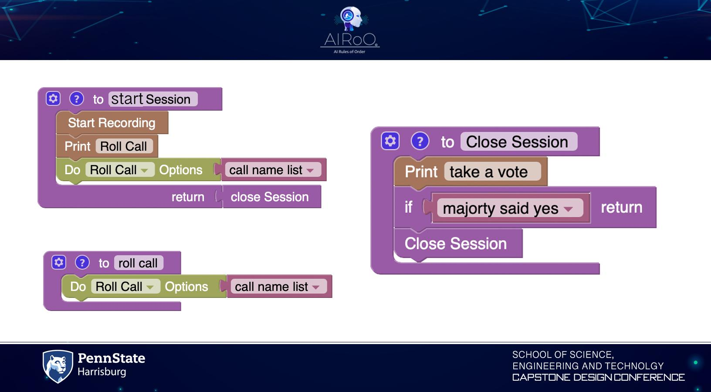

Slide 7
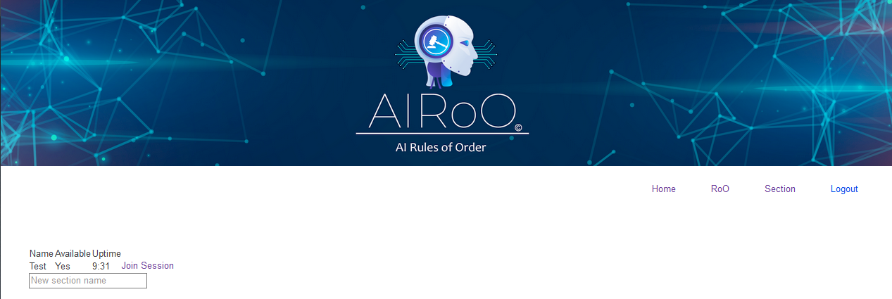

Slide 8
